Slide 1

Victor Valley Community College District
FY 2022 - 2023
Final Budget

Slide 2
Economic Update
COVID-19 Pandemic has been disrupting our state and national economy since March 2020. The State is providing an additional $650 Million one-time support to community college district’s.
The State of California projects total budget plan of $300 billion for the fiscal year with $55 billion more in taxes expected in January with $97.5 Billion surplus.
This State budget supports Community Colleges with the Vision for Success providing increased funding for equitable student success and loss of enrollment.

Slide 3
Fiscal Year 2021 - 2022

Slide 4
2021-22 Revenue Recap
Total Computational Revenue (TCR) calculated from the Student Centered Funding Formula (SCFF) and reflecting available revenues.
Advanced Apportionment:
$60,760,554
First Principal Apportionment:
$67,827,248
Second Principal Apportionment
TCR: $70,596,360
Available Revenue: $70,596,360
Deficit of $0

Slide 5
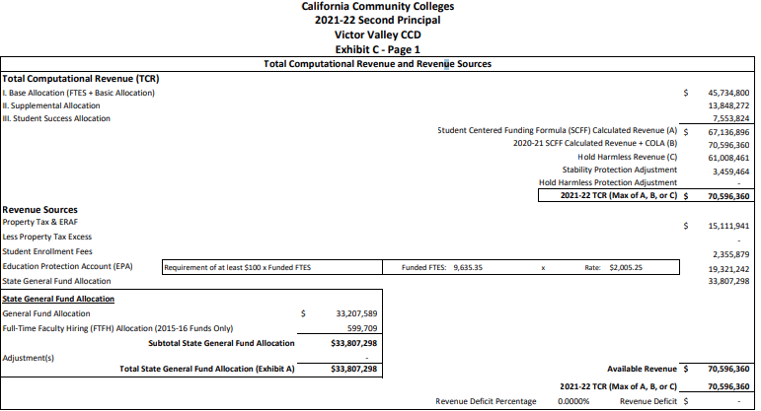

Slide 6
2021-22 Unaudited Actuals
Total Computational Revenue (TCR) of $70,596,360
Surplus of $8,687,979
Ending fund balance of $21.8 million, 28.89%

Slide 7
General Fund Savings Actual vs Budget FY 2022
Revenue:
$1,594,502 Taxes came in higher along with increased enrollment
Expenditures:
$2,271,319 Savings from Classified Budgeted Salaries
$2,396,150 Savings from Certificated Budgeted Salaries
$1,747,530 Savings from Employee Benefits Budget
(positions budgeted for full year, vacancies savings and positions filled during Fiscal Year)
$491,421 Unused President’s Contingency
-$174,999 Operating Costs Increased due to Utilities Cost
Notes:
Not updated yet

Slide 8
State Adopted Budget 2022-2023

Slide 9
Impact of Adopted State Budget (June 2022) - Categorical -
Retention & Enrollment - $150 million, Additional One-time funding – VVC Allocation $1,349,061
Deferred Maintenance & Instructional Equipment – $840 million, Additional One-time funding – VVC Allocation $8,946,910
COVID-19 Recovery Block Grant - $650 million, One-time funding – VVC Allocation $5,818,262
Student Equity & Achievement program – 5% increase, $524 million – VVC Allocation $4,039,308
Student Success Completion Grant Program – 153.8% increase, $412.6 million – VVC Allocation $6,482,860 (SCFF Funding)
Part-time Faculty Health Insurance - $200 million - Application
EOPS – 25% increase, $169 million – VVC Allocation $2,206,728
CARE – 57.5% increase, $30.9 million – VVC Allocation $358,196
DSPS – 26% increase, $159.7 million – VVC Allocation $1,003,977
California College Promise Program – 25.8% increase, $91 million – VVC Allocation $443,691
Apprenticeship – 15% increase, $69 million – N/A
Notes:
Not updated

Slide 10
Impact of Adopted State Budget (June 2022) - Categorical, Continued -
Basic Needs for Food Insecurity - $70 million ($30 million, One-time) – VVC Allocations $659,952
NextUp – 150% increase, $50 million – VVC Allocation $1,156,435
Student Housing Program – 111% increase, $19 million – VVC Allocation $700,000
Rising Scholars Network - $25 million - TBD
Information Technology & Security – $110 million ($75 million, One-time) - TBD
Notes:
Not updated

Slide 11
Impact of Adopted State Budget - Apportionment -
Student Centered Funding Formula - $8.7 billion
COLA – 6.56% for various categorical programs
Up from 5.70% in 2021-22
Notes:
Not updated

Slide 12
General Fund Assumptions
The District shall maintain legal compliance with the 50% law.
The District will develop a budget with a minimum 16.7% ending fund balance (reserve) per revised Board Policies 6200 – Budget Development and 6250 Budget Management
The Program Review, Planning, and Budget Development Process will guide the allocation of resources
Vacancies due to retirement or resignation will not automatically be filled
Based upon the State’s Adopted Budget, an Operating Budget has been prepared which includes estimated revenues and expenditures for 2022-23 fiscal year

Slide 13
Revenue Assumptions
There is a 6.56% COLA for the 2022-23 fiscal year
Hold Harmless protections extended through fiscal year 2024-25
FY 2021-22 Budget Stabilization = $3,459,464

Slide 14
Expense Assumptions
Public Employee Retirement System (PERS) district contribution increased by 2.46% to 25.37%.
State Teachers Retirement System (STRS) increased by 2.18% to 19.10%.
A 1% President’s Contingency has been established.
No budget augmentation funds have been allocated.

Slide 15
Cautions and Concerns for 2022-2023
Return to normal operations
We will not continue to see General Fund Savings experienced in 2020-21 & 2021-22
Increased inflation
Increased benefit rates
Revenue losses due to COVID-19 will continue to be covered using HEERF funds through 2022-23
Losses are due to decreased enrollment
We will need to recoup loss enrollment to stabilize revenue

Slide 16
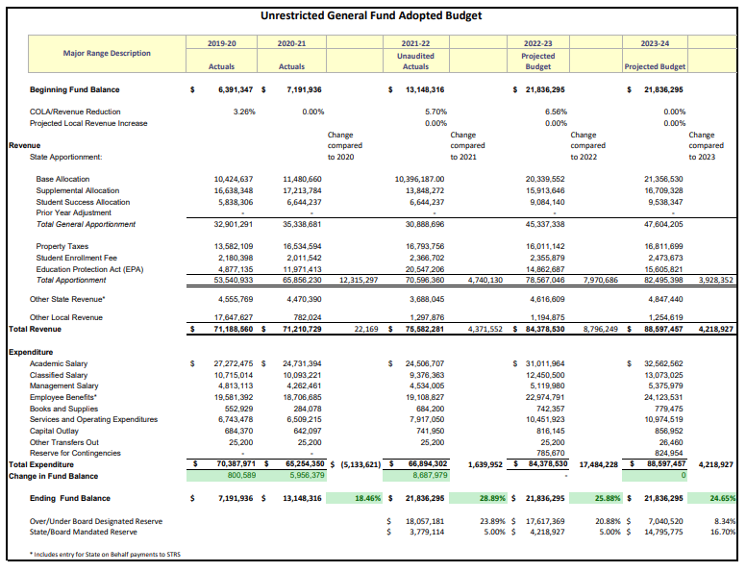

Slide 17
Student Enrollment (FTES)
Issues to consider
Changing economics
Enrollment Management
 | FY 16/17 | FY 17/18 | FY 18/19 | FY 19/20 | FY 20/21 | FY 21/22
FTES | 9475 | 9640 | 9190 | 9565 | 7676 | 8184*
*at P2

Slide 18
Budget Overview of All Funds

Slide 19
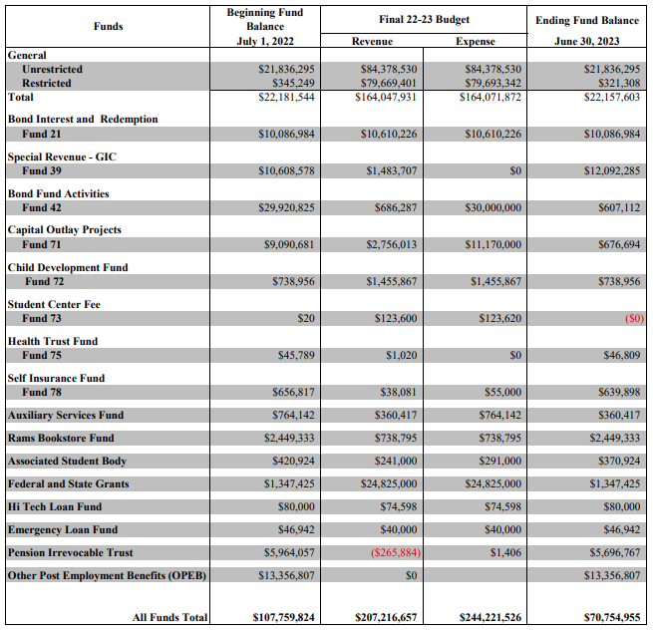
Notes:
Needs to be updates

Slide 20
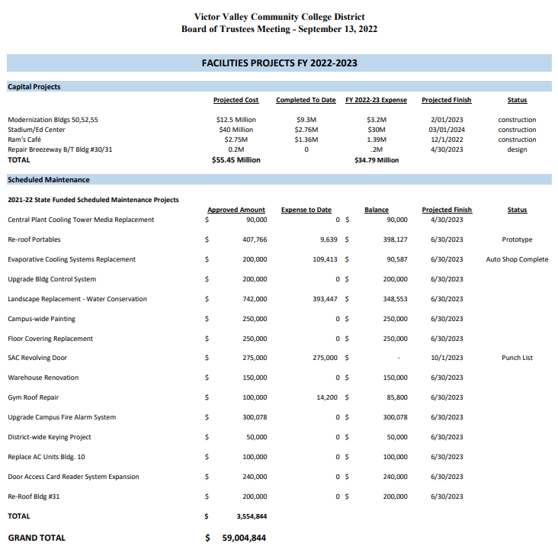
Notes:
Needs to be updated

Slide 21
COVID-19 Relief Funds

Slide 22
COVID-19 Relief Funds
$18,666,130 was disbursed to students through August 2022
$8,531,672 of Institutional funding was spent during 21-22
Institutional funding has been used for the following:
The cost of additional courses/labs due to social distancing requirements
Counselors for re-engagement
Supplemental grants for Veterans
Laptops and internet connections for students
Personal Protective Equipment
Loss revenue
Unspent funds carried forward into 2023
Student Aid $4,915,152
Institutional Funding $30,877,573

Slide 23
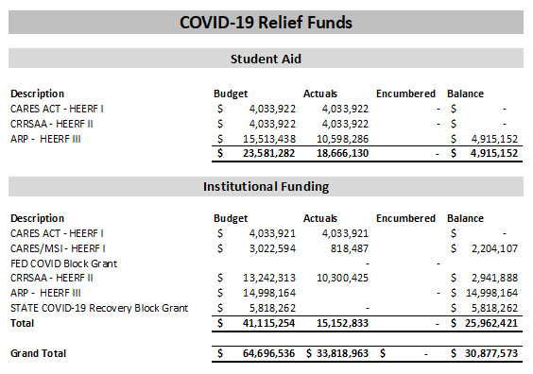

Slide 24
Questions?

